Slide 1
Module-3

Slide 2
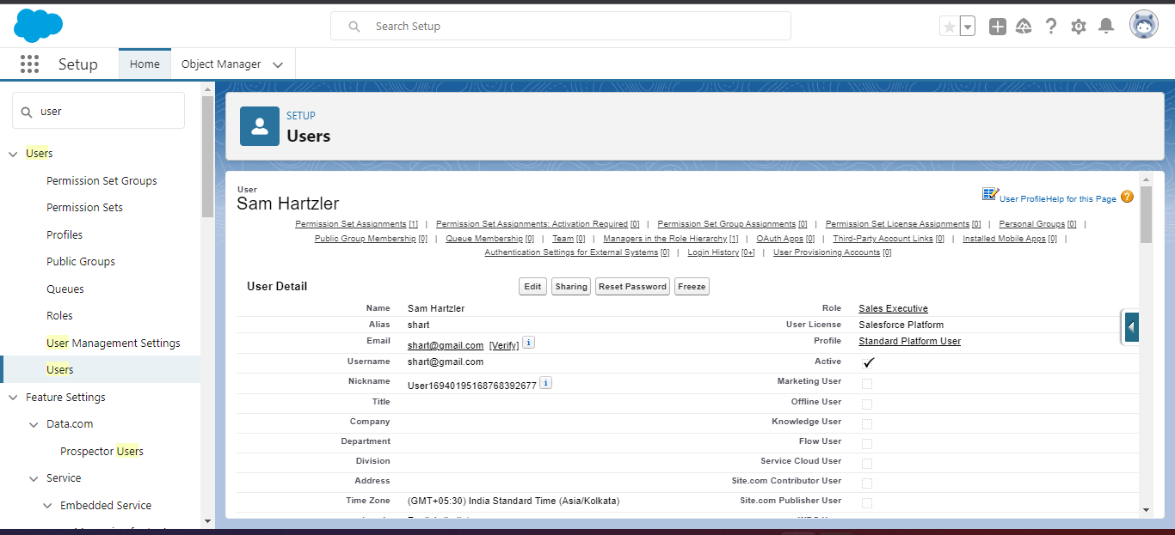
Creating user Sam and assigning sales executive profile and setting reporting to CEO.

Slide 3
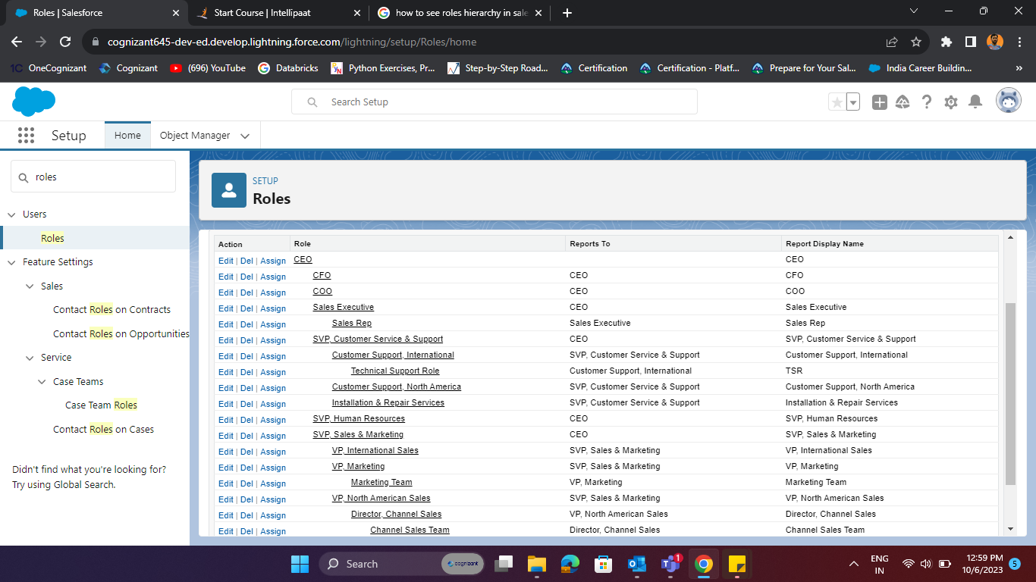

Slide 4
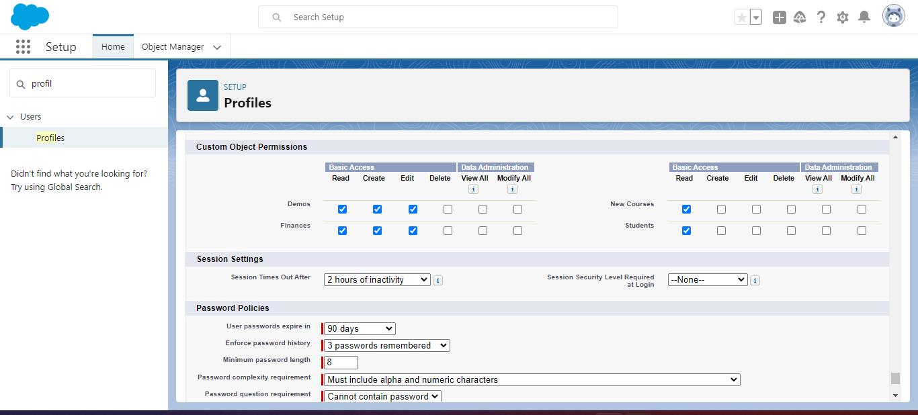
Object level security through profiles
A.i)

Slide 5
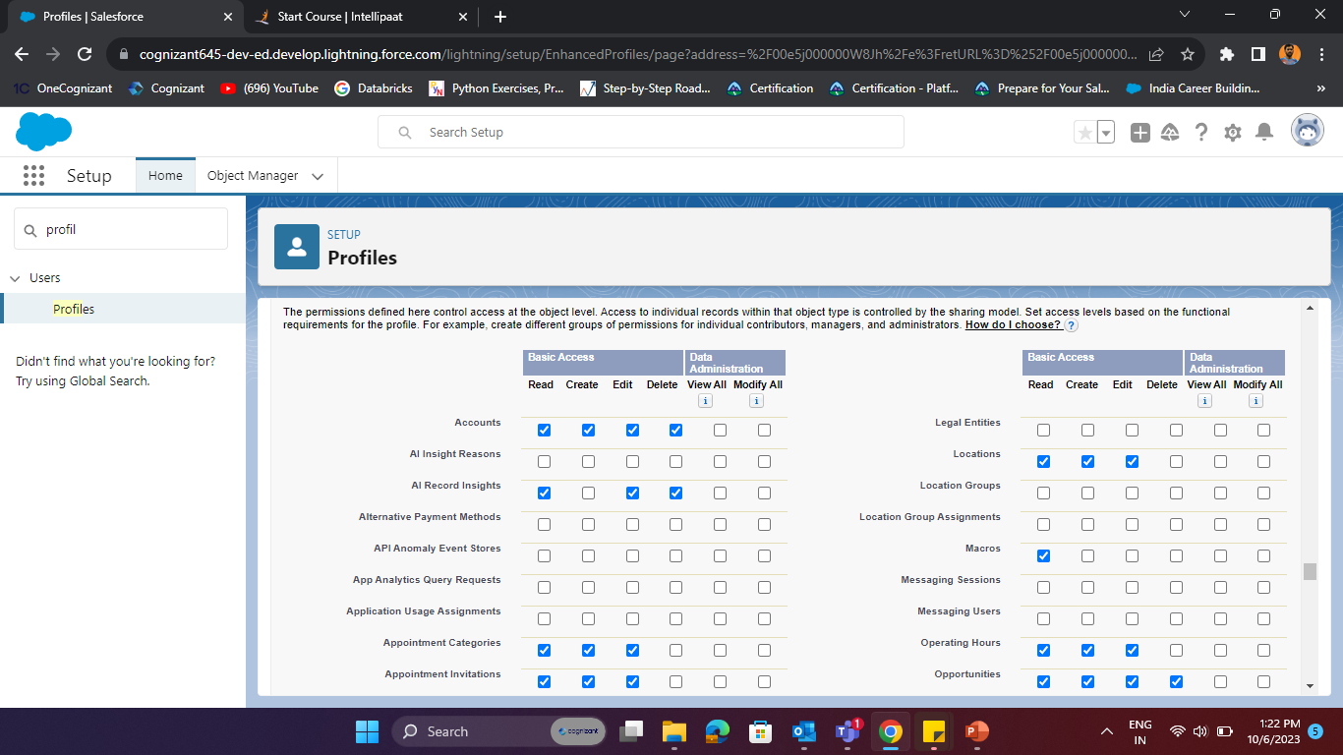

Slide 6
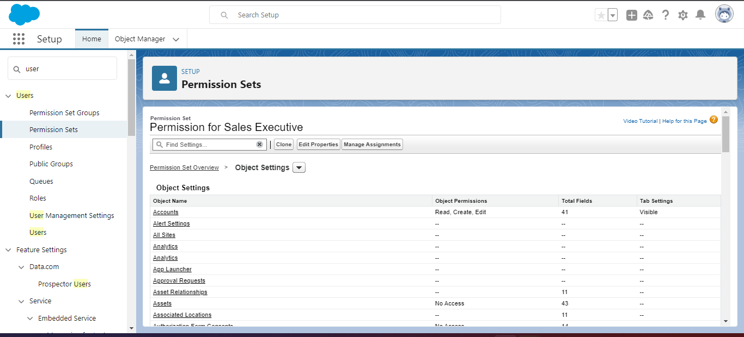
Object level access through permission set
A.ii)

Slide 7
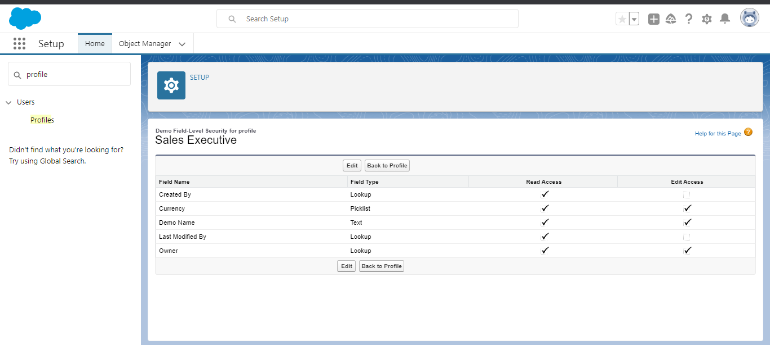
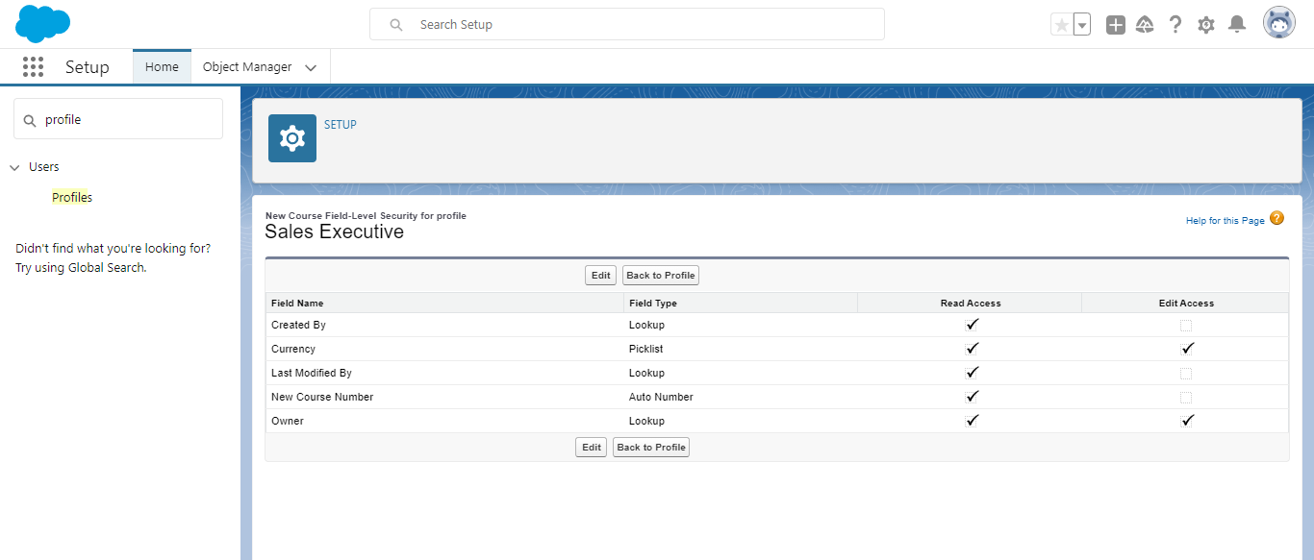
Field level security through profile
B.i)

Slide 8
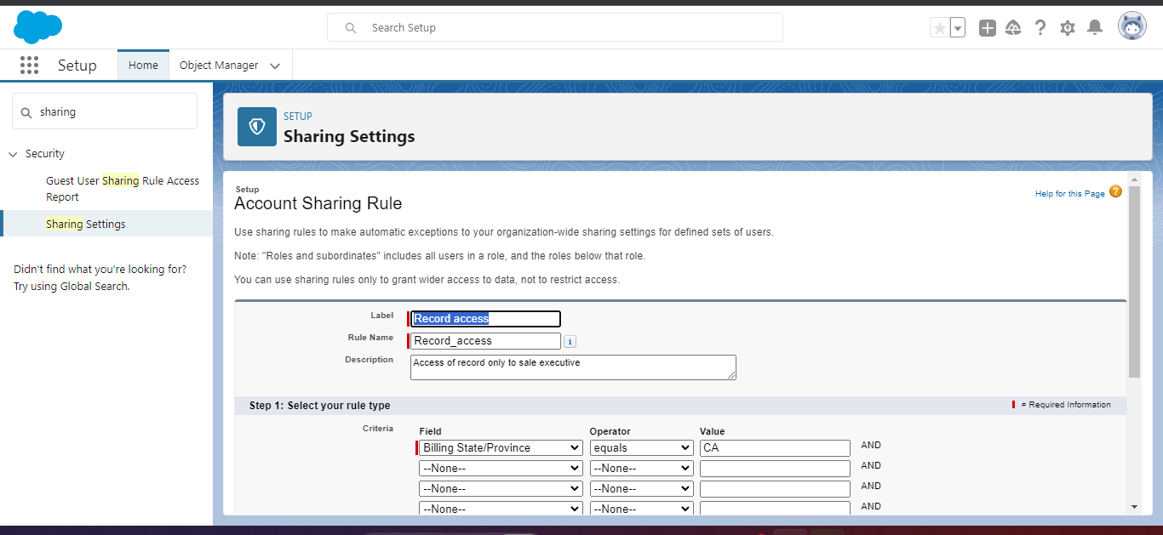
Record level security through sharing rule

Slide 9
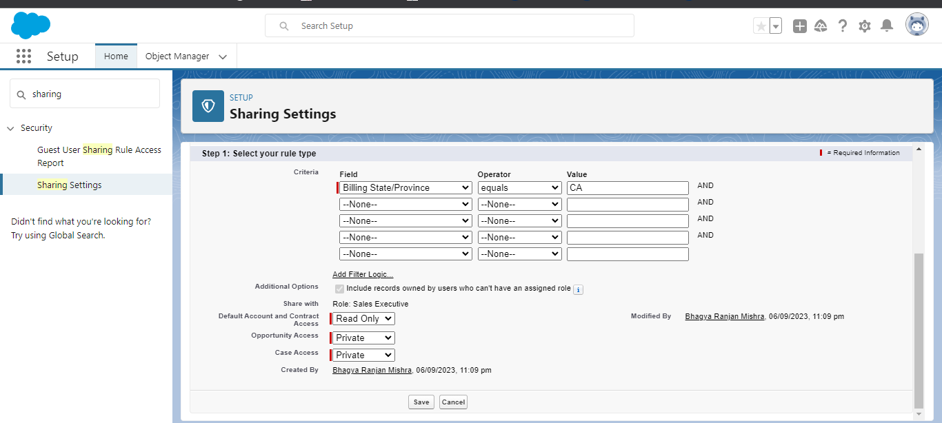

Slide 10
Sales Executive reports to CEO Zeck and he has two Sales Rep reporting to him Jane and John

Slide 11
